Slide 1
Open Data: How to Make Supply and Demand Meet?
Beat Estermann, 12 June 2013

Slide 2
Personal Background
Member of the Research Group «Open & Linked Data» at the
E-Government Institute (Bern University of Applied Sciences)
Personal Research Field: Open Data and Crowdsourcing among Memory Institutions (cf. Pilot Survey among Swiss GLAMs)
Member of opendata.ch (Swiss chapter of the Open Knowledge Foundation)
Member of Wikimedia CH, participating in GLAM-Wiki co-operations
Founding member of Digitale Allmend (Swiss chapter of CreativeCommons)
Motivation for the participation in today’s workshop:
Getting a better understanding of the demand side of open data in the Digital Humanities

Slide 3
Content Overview
Providers and Users of Open Data
Challenges from a Data Provider Perspective
Challenges from a User Perspective (in the Digital Humanities)
Approches to Making Demand and Supply Meet:
  « Master Classes » for professionals in the cultural heritage sector
  Hackathons
  Apps to facilitate data use / visualization, data collection by crowdsourcing, or classification / transcription tasks
Questions for Discussion

Slide 4
Who are the Providers of Open Data?
Research organizations (Open Science Data)
Public sector organizations (Open Government Data)
Para-public organizations (e.g. in the Cultural Heritage sector)
Wikipedia – DBpedia – Wikidata
Findings from our pilot study among memory institutions in Switzerland (N=72)* :
Between 1% and 7% of responding memory institutions make scans/photographs of some of their memory objects «freely» available on the Internet.
Over half of them make them available on the Internet, but with restrictions. 40% don’t make them available at all.
For 80% of responding institutions, the opportunities outweigh the risks of Open Data; over 50% think Open Data is an important issue.
Conclusion: Open Data is just at the beginning of its diffusion process among memory institutions in Switzerland.
* Estermann, B. (2013, forthcoming): Schweizer Gedächtnisinstitutionen im Internet-Zeitalter. Ergebnisse einer Pilotbefragung zu den Themenbereichen Open Data und Crowdsourcing, E-Government-Institut der Berner Fachhochschule.

Slide 5
Who are the Users of Open Data?
Findings from the Swiss Open Government Data Study (based on a survey among Cantonal Chancelleries; N=18)*:
The Media (mentioned by 10 Cantonal Chancelleries)
Private Companies (7)
Public Authorities (7)
Private Individuals (7)
Research and Education (3)
Politicians (1)
Findings from our pilot study among memory institutions in Switzerland (N=72):
Research (for 68% of responding institutions this “is the case”, score “1” on a 4-point Likert scale)
Education (65%)
Private Individuals / General Public (53%)
Cultural Institutions (50%)
Public Authorities (29%)
Private Companies (11%)
* Golliez, A. et al. (2012): Open Government Data Studie Schweiz, Berner Fachhochschule und itopia.

Slide 6
Challenges from a Data Provider Perspective
Findings from our pilot study among memory institutions in Switzerland:
Major risk: extra time effort and expenses
Considerable risks: loss of control, copyright, data protection, secrecy infringements
Almost no risk: Loss of revenues
Not evaluated: the role of copyright in preventing content from being added to the data commons.

Slide 7
Challenges from a User Perspective
Awareness
Techniques and methods to handle digital data are hardly taught in the Humanities.
Availability of data that fit the research question
The most useful data may not be available as Open Data or be only partly available – e.g. for one jurisdiction, but not for others.
Technical know-how / access to easy-to-use tools
Loss of control if technical experts are needed to carry out the research.
Research methodologies leading to sophisticated demands
Projects are often quite complex from a technical perspective.
Requirements with regard to data quality and integrity
Data storage systems are needed that guarantee permanent access and integrity of the data in order to ensure traceability/confirmability of research results.

Slide 8
Trainings for Cultural Heritage Professionals:
«Open Culture Data Masterclasses» in the Netherlands
Topics treated:
  Building Blocks of Copyright
  Technology and Tools (from open licensing to APIs)
  Reuse and applications
  Benefits and risks
  Hackathons
Representatives of « first mover » institutions act as coaches for the course participants

Slide 9
Hackathons and App Competitions
Data Providers
Copyright / Open Data Experts
Developers
Domain Experts
End Users
«Enterpreneurs»
«Problem Ownership»
Sustainability / Funding
Output: Software prototypes that use real data.

Slide 10
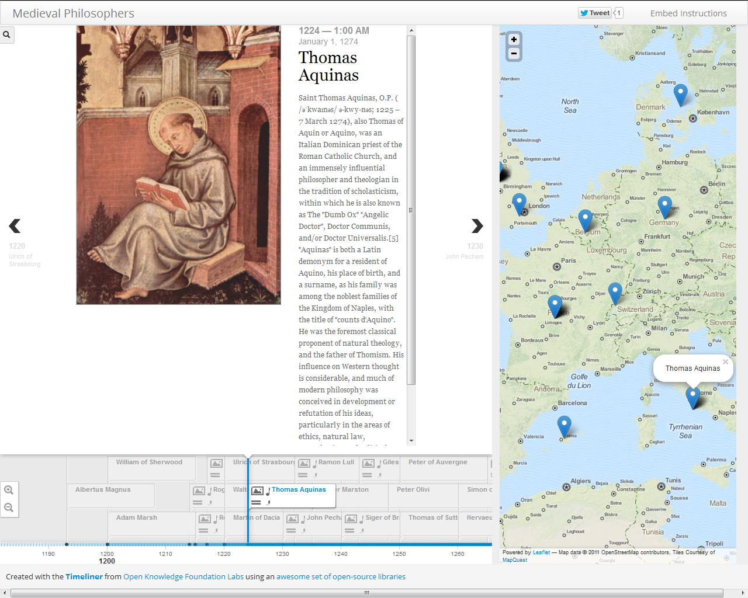
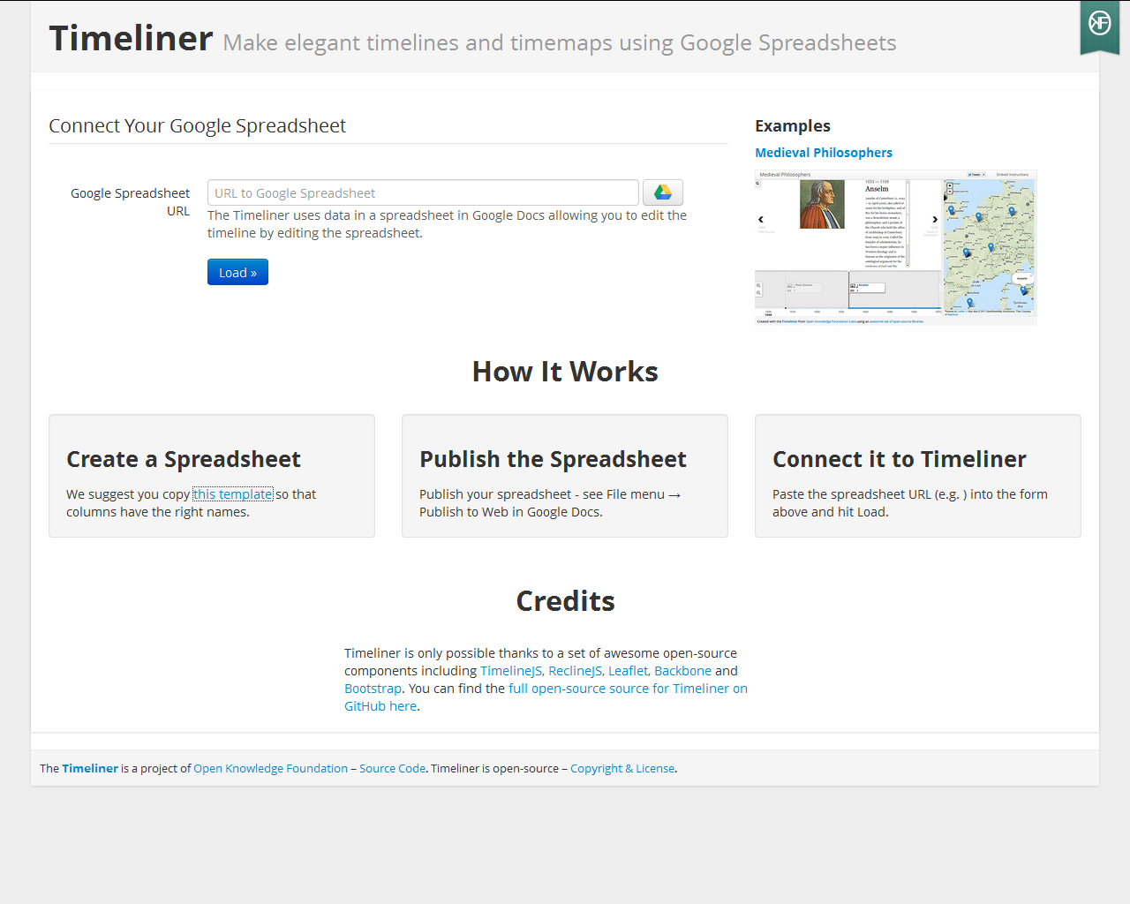
Example App that Facilitates Data Visualization:
Time Liner Tool
http://timeliner.okfnlabs.org/

Slide 11
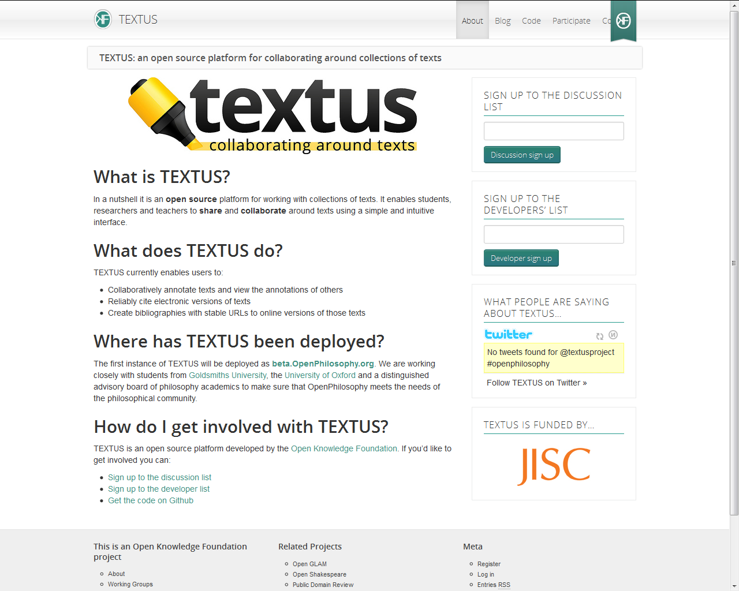
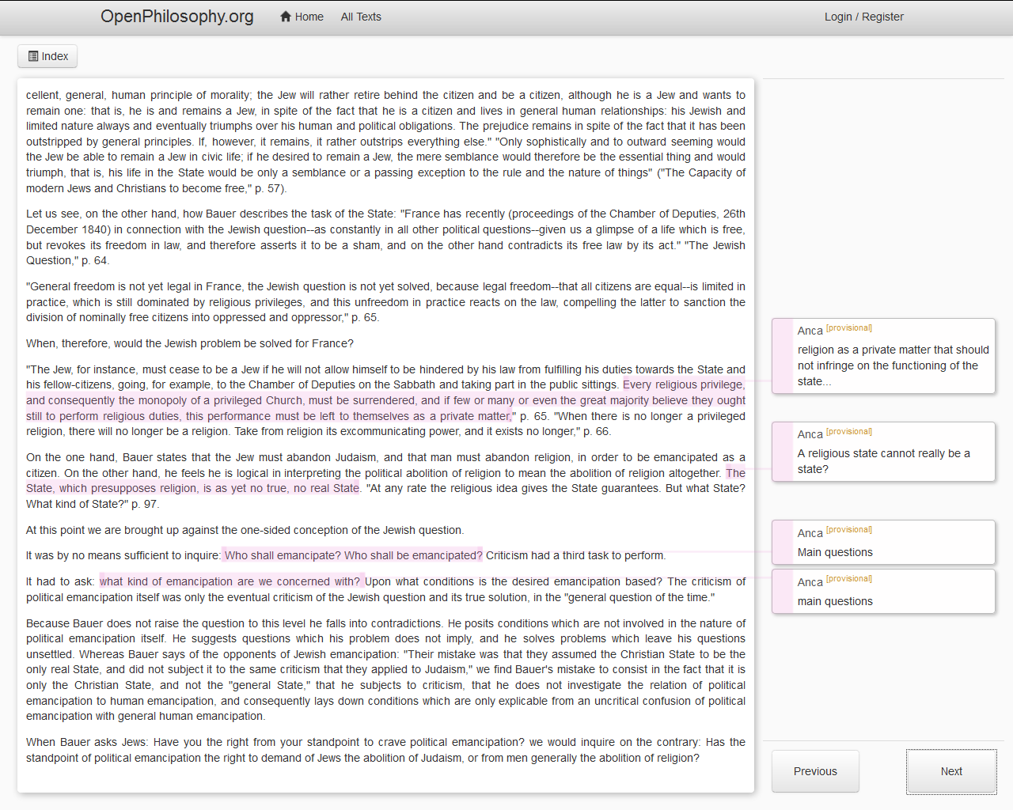
Example Apps that Facilitates Collaborative Use of Data: Annotation Tool TEXTUS
http://textusproject.org/

Slide 12
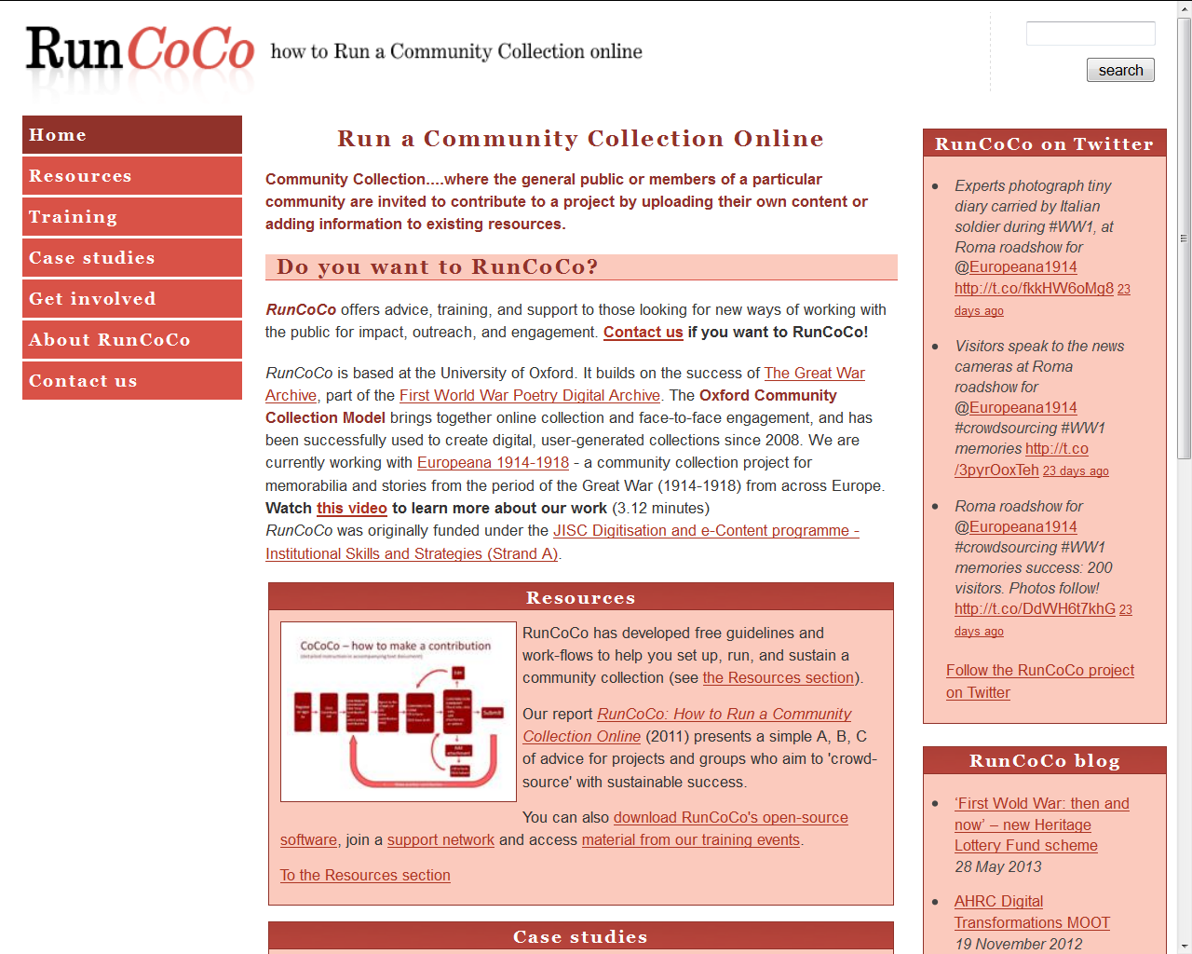
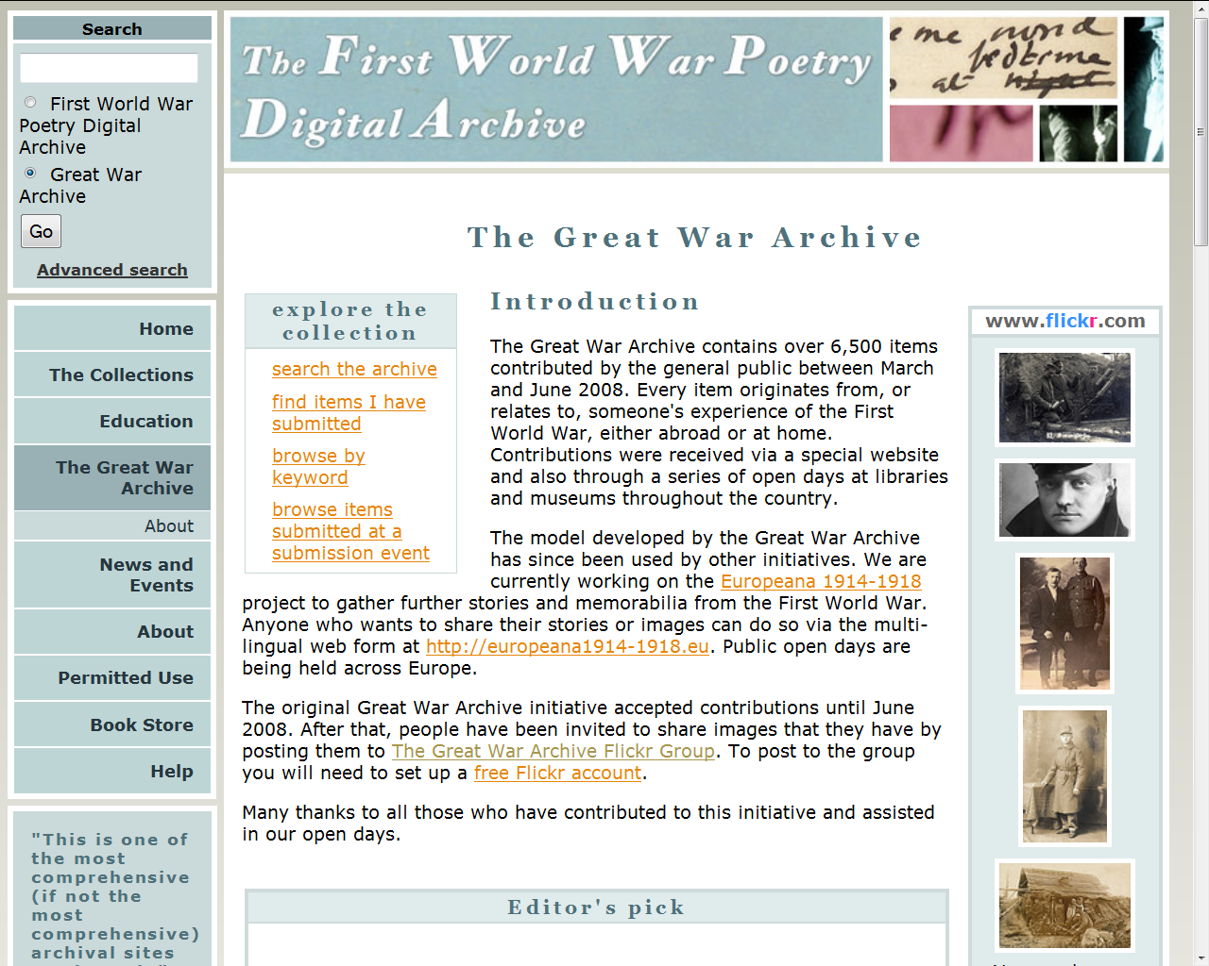
Example App for Data Collection:
Community Collection Online (The Great War Archive)
http://projects.oucs.ox.ac.uk/runcoco/

Slide 13
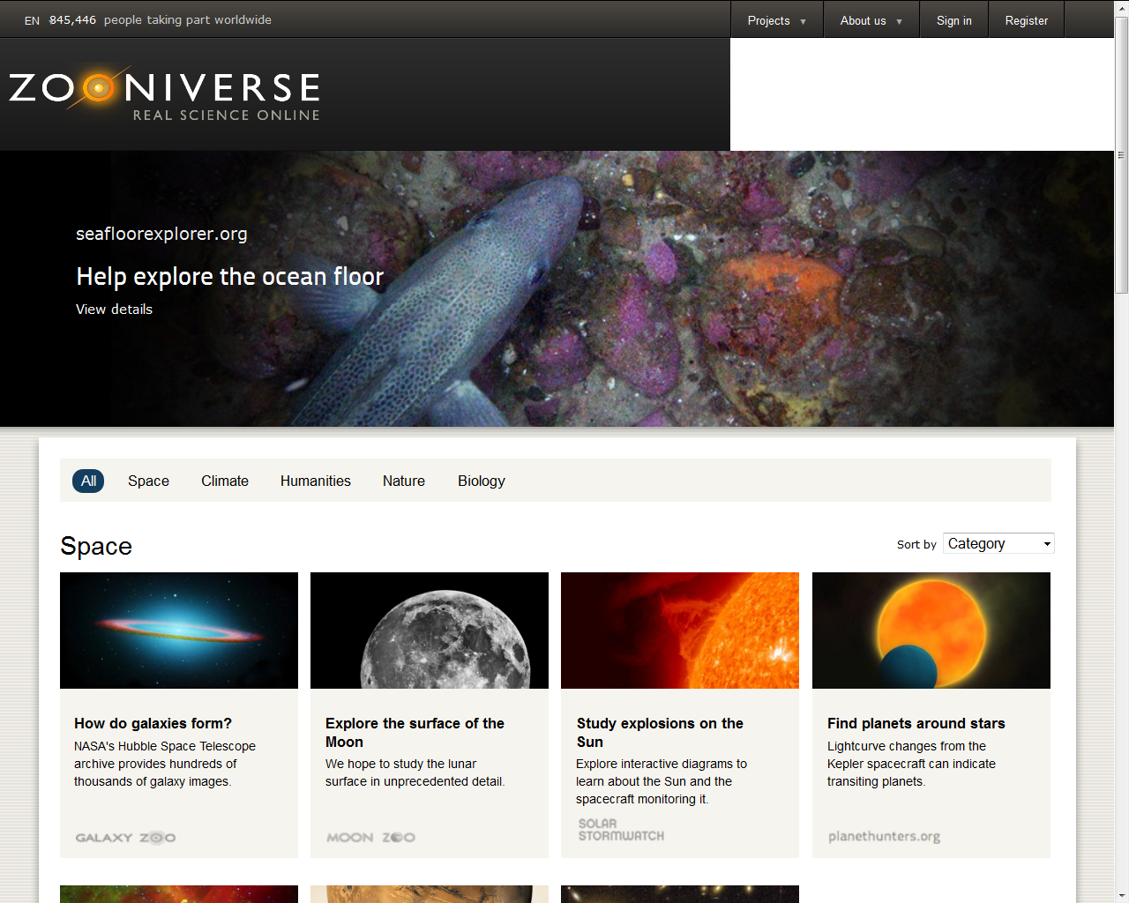
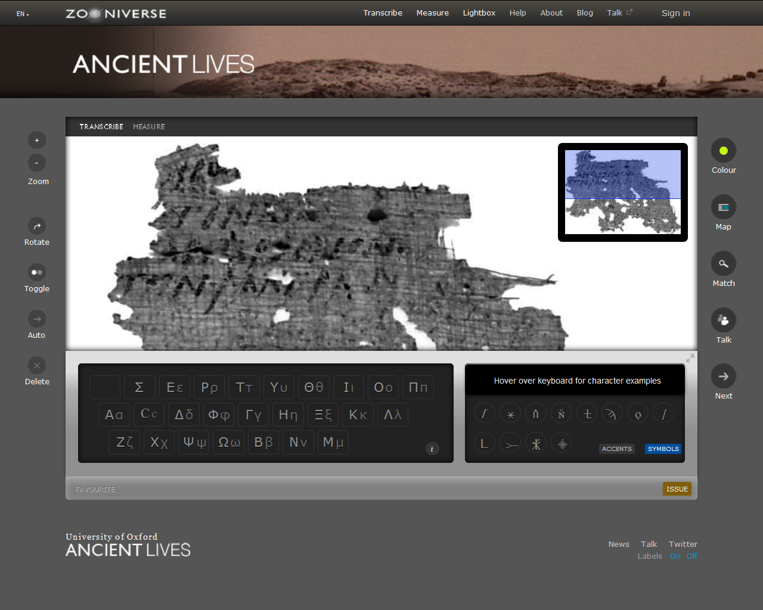
Example: Hosting Platform for Citizen Science Projects:
Zooniverse (Ancient Lives)
https://www.zooniverse.org/

Slide 14
Questions for Discussion
What are your experiences regarding challenges on the demand / supplier side?
What should be done (in Switzerland) to make data/content supply and demand in the Digital Humanities meet? What would be most useful?

Slide 15
Contact
Beat Estermann
beat.estermann@bfh.ch
Bern University of Applied Sciences
E-Government Institute
Morgartenstrasse 2a
3000 Bern 22

